Slide 1
STAT 7900: Special Topic:
Causal Analysis
Instructor
Dhrubajyoti Ghosh
KENNESAW STATE UNIVERSITY
STAT 7900

Slide 2
Final Project
Slide: Final Project Topics
Observational Causal Analysis: Estimate the causal effect of an exposure or treatment using real observational data and appropriate adjustment methods.
Heterogeneous Treatment Effects: Investigate how causal effects vary across individuals or subgroups.
Instrumental Variables / Natural Experiments: Estimate causal effects when treatment is confounded using a defensible instrumental-variable strategy.
Policy Evaluation: Evaluate the causal impact of a policy using Difference-in-Differences, event-study, or synthetic-control methods.
Causal Discovery: Use observational data to learn and evaluate plausible causal structures and relationships.
Students may work individually or in teams of two. Applied, methodological or theoretical projects are all welcome.

Slide 3
Final Project
Deadline | Deliverable
October 12 | Project Proposal: topic, dataset, causal question/objective, treatment, outcome, target population and proposed approach.
November 9 | Introduction & Literature Review: motivation, existing literature, research gap and updated analysis plan.
December 7 | Final Project & Presentation: complete paper, reproducible analysis/code and presentation.
Goal: Develop the project in the format of a research study; particularly strong projects may be suitable for further development toward publication.

Slide 4
Questions
A model predicts heart attack with AUC = 0.94 using smoking status. Does that establish a causal effect?
Why can Simpson’s paradox occur?
Write one predictive and one causal question about college GPA.

Slide 5
Questions
A model predicts heart attack with AUC = 0.94 using smoking status. Does that establish a causal effect?
No. High predictive accuracy does not establish that smoking causally affects heart attacks.
Why can Simpson’s paradox occur?
Write one predictive and one causal question about college GPA.

Slide 6
Questions
A model predicts heart attack with AUC = 0.94 using smoking status. Does that establish a causal effect?
No. High predictive accuracy does not establish that smoking causally affects heart attacks.
Why can Simpson’s paradox occur?
Because a third variable can affect both group membership and the outcome, causing aggregate and within-group associations to differ.
Write one predictive and one causal question about college GPA.

Slide 7
Questions
A model predicts heart attack with AUC = 0.94 using smoking status. Does that establish a causal effect?
No. High predictive accuracy does not establish that smoking causally affects heart attacks.
Why can Simpson’s paradox occur?
Because a third variable can affect both group membership and the outcome, causing aggregate and within-group associations to differ.
Write one predictive and one causal question about college GPA.
Predictive: Can study hours predict college GPA? Causal: Would increasing study hours improve college GPA?

Slide 8
Recap
Prediction
Can a pattern predict the outcome in new data?
High predictive accuracy may reflect confounding, selection, or consequences of treatment.
Causation
What would change if we intervened?
A causal claim requires a counterfactual comparison plus assumptions.

Slide 9
Recap
The scientific question determines the analysis.
Association: E[Y | T = 1] − E[Y | T = 0]
Causal effect: E[Y(1)] − E[Y(0)]
These two quantities can be very different.

Slide 10
What is Causal Effect?
A causal effect compares two possible worlds that differ in the treatment.
World 1
The unit receives treatment.
T = 1
World 0
The same unit does not.
T = 0

Slide 11

Example 1
Does tutoring help Sarah?
Sarah attends tutoring and scores 88 on the final exam.
We cannot answer from 88 alone.
We also need to know what Sarah would have scored without tutoring.
Tutoring: $Y\left(1\right)=88$, No tutoring: $Y(0) = ?$
Individual causal effect =$Y\left(1\right)−Y(0)$

Slide 12
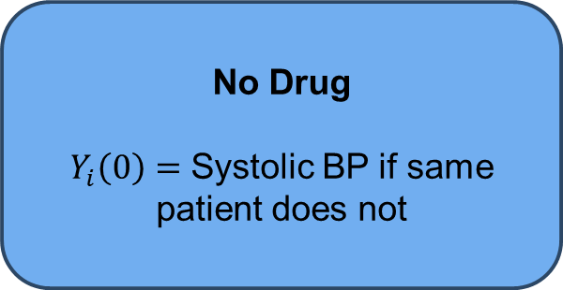
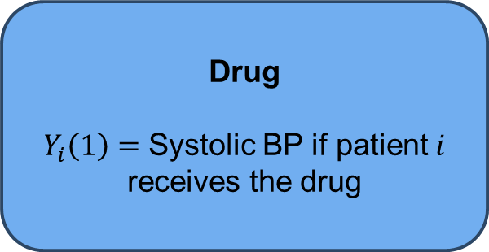
Example 2: Medicine
Drug
$Y_{i}\left(1\right)=$ Systolic BP if patient $i$ receives the drug
No Drug
$Y_{i}\left(0\right)=$ Systolic BP if same patient does not
If $Y_{i}\left(1\right)=128$ and $Y_{i}\left(0\right)=142$, then the causal effect is $−14$.

Slide 13

Example 3: Policy
Would raising a state minimum wage change employment next year?
$Y\left(1\right)=$ Employment under the wage increase
$Y\left(0\right)=$ Employment without the wage increase
The state cannot live through both versions of the same year.

Slide 14
Example 4: Sports
Would the team have won if the red card had not occurred?
Observed Match
Red card occurred.
Team Lost
Counterfactual Match
No red card
What would have happened?

Slide 15

Potential Outcomes
$$T_{i}∈\{0,1\}$$
$Y_{i}\left(1\right)=$ Outcome unit $i$ would have under treatment
$Y_{i}\left(0\right)=$ Outcome unit $i$ would have under control
Causal effect: $τ_{i}=Y_{i}\left(1\right)−Y_{i}(0)$
We observe only the potential outcome corresponding to the treatment received.
$$Y_{i}=T_{i}Y_{i}\left(1\right)+\left(1−T_{i}\right)Y_{i}(0)$$
If $T_{i}=1, Y_{i}=Y_{i}(1)$ and if $T_{i}=0, Y_{i}=Y_{i}(0)$.

Slide 16

Potential Outcomes
Binary treatment is just the simplest case.
Multi-level treatment: $Y_{i}\left(0\right), Y_{i}\left(1\right), Y_{i}\left(2\right), …$
Continuous Treatment: $Y_{i}(t)$ for dose $t$.
Time-Varying treatment: Potential outcome depends on a treatment history.
Dynamic regimes: Treatment can depend on previous covariates or outcomes.
We start with $T∈\{0,1\}$ because the causal logic is simplest there.

Slide 17
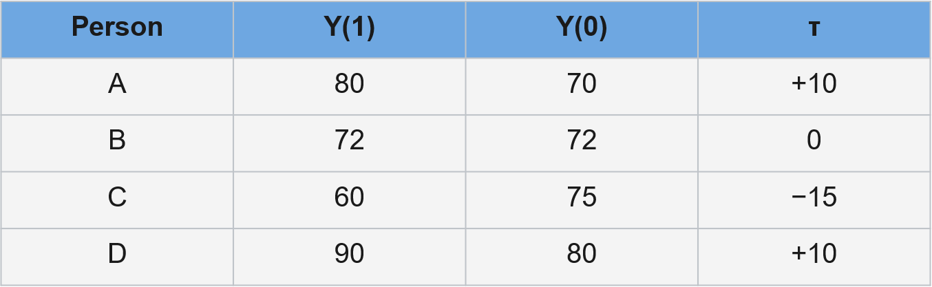
Individual Causal Effects
$$τ_{i}=Y_{i}\left(1\right)−Y_{i}(0)$$

Slide 18
Individual Causal Effects
We can have same treatment, different responses.
“Does the treatment work?” is often an incomplete scientific question.
What should causal questions specify?
Population: For whom?
Treatment: Which intervention?
Comparator: Compared with what?
Outcome: What is being measured?
Time: Over what follow-up period?

Slide 19
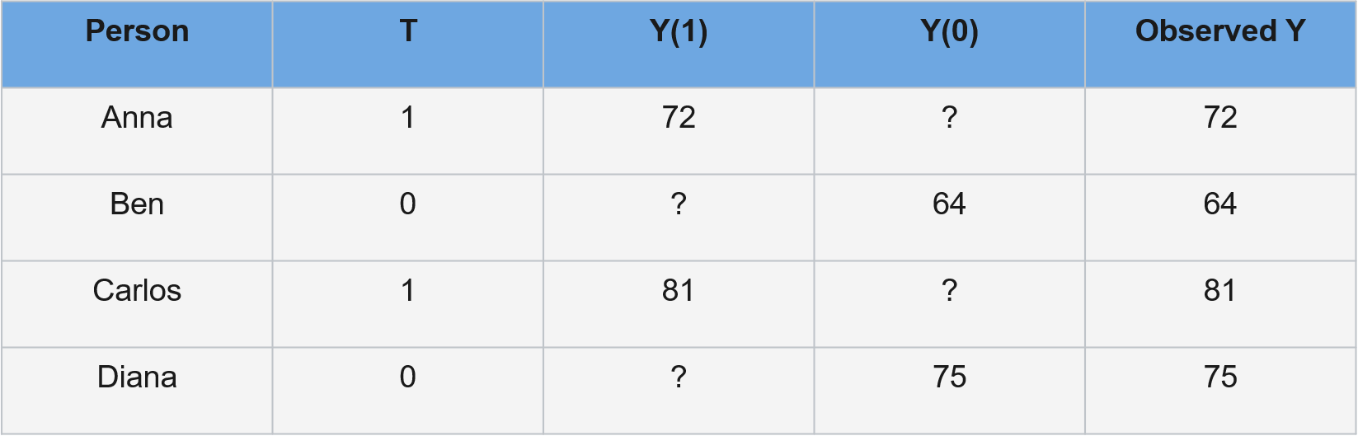
What do we actually observe?
Every person is missing one potential outcome.

Slide 20

Fundamental problem of causal inference
For each unit, we can observe $Yᵢ(1)$ or $Yᵢ\left(0\right).$
Never both at the same time.
Observed: Factual Outcome.
Missing: Counterfactual Outcome.

Slide 21

Fundamental problem of causal inference
A causal inference problem is a missing-data problem.
Observed: $(T_{i}, Y_{i}, X_{i})$
Missing: $Y_{i}(1−T_{i})$
The missingness is structural: every unit is missing exactly one potential outcome.
We cannot recover the missing value for an individual without very strong assumptions.
But we may identify averages by comparing suitable groups.

Slide 22

How can Causal Inference be possible?
We stop trying to estimate individual causal effects.
Instead, we target population averages that can be identified under assumptions.
$$τ_{i}→E[τ_{i}]$$
Average Treatment Effect (ATE):
$$ATE=E\left[Y\left(1\right)−Y\left(0\right)\right]=E\left[Y\left(1\right)\right] −E\left[Y\left(0\right)\right]$$
Average effect if the target population were treated versus if the same target population were untreated.
ATE answers a population-level intervention question.

Slide 23
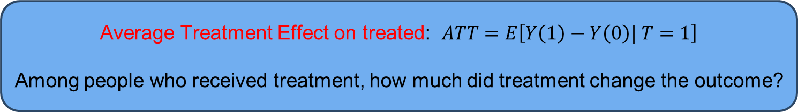
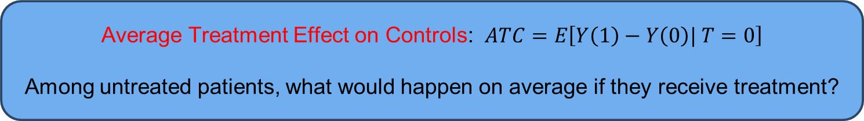
ATE, ATT, ATC
Average Treatment Effect: $ATE=E \left[Y\left(1\right)\right]−E \left[Y\left(0\right)\right]$
Average Treatment Effect on treated: $ATT=E\left[Y\left(1\right)−Y\left(0\right)| T=1\right]$
Among people who received treatment, how much did treatment change the outcome?
Average Treatment Effect on Controls: $ATC=E\left[Y\left(1\right)−Y\left(0\right)| T=0\right]$
Among untreated patients, what would happen on average if they receive treatment?

Slide 24
Conditional Average Treatment Effect (CATE)
CATE(x) = E[Y(1) − Y(0) | X = x]
Example
Another subgroup
CATE(age > 65) = −10 mmHg
CATE(age < 40) = −2 mmHg
This is the language of treatment-effect heterogeneity.

Slide 25
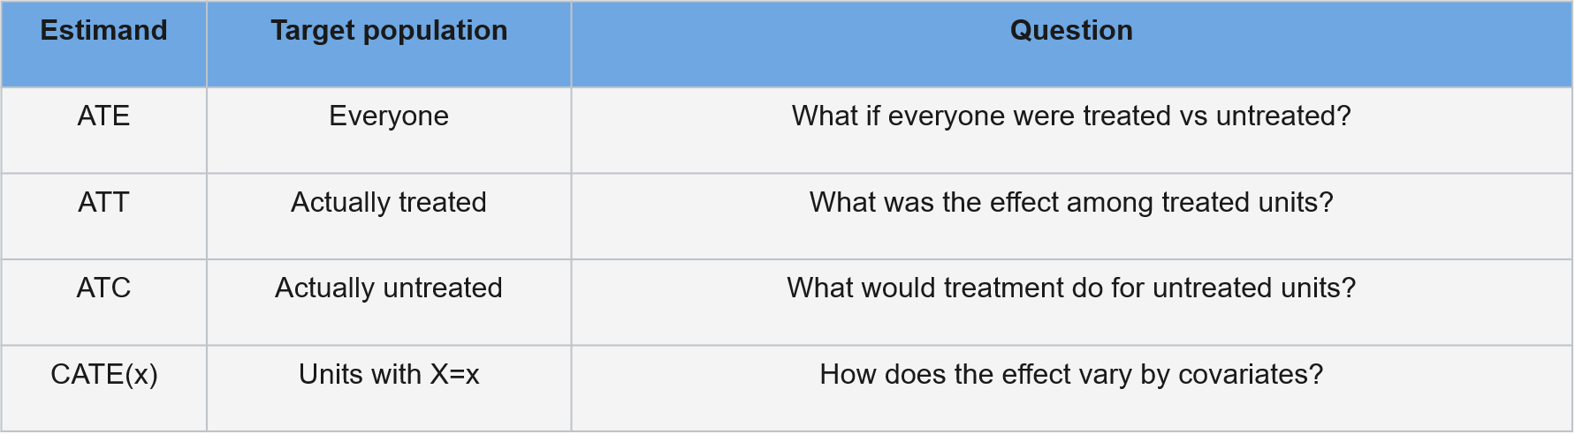
Different estimands answer different questions

Slide 26
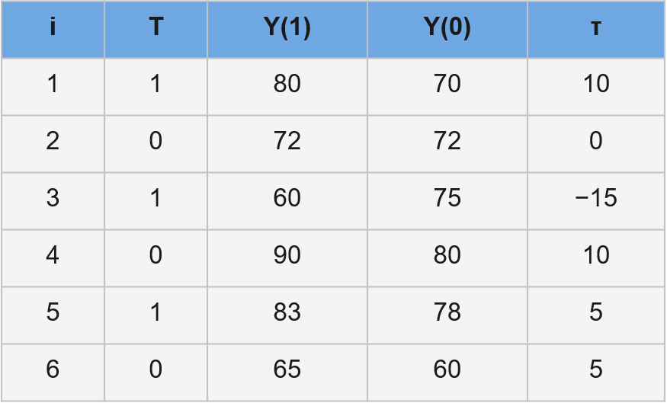
Worked Examples

Slide 27
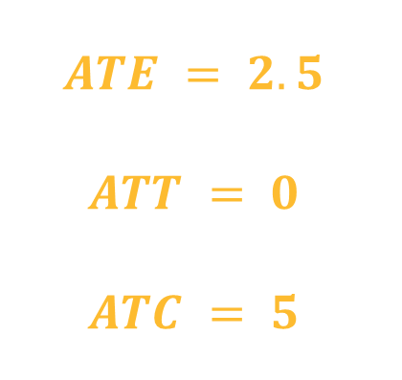
Worked Examples
$$ATE = 2.5$$
$$ATT = 0$$
$$ATC = 5$$

Slide 28
Worked Examples
$$ATE = P(T=1)·ATT + P(T=0)·ATC$$
In the previous example, half the population is treated and half untreated.
$$0.5(0) + 0.5(5) = 2.5$$

Slide 29
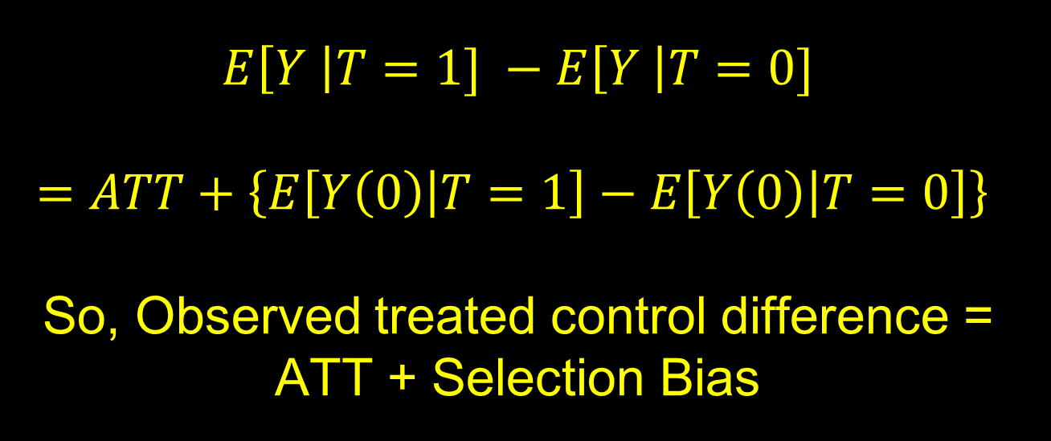
Bias Decomposition
$$E\left[Y \right|T=1] −E\left[Y \right|T=0]$$
$$=ATT+\left\{E\left[Y\left(0\right) | T=1\right]−E\left[Y\left(0\right) | T=0\right]\right\}$$
So, Observed treated control difference = ATT + Selection Bias
The treated and untreated groups can differ for two reasons: treatment changed the outcome, and they were different even before treatment.

Slide 30

Bias Decomposition: Example
Suppose: people who get treatment has an average outcome of 80 and untreated group has $70$.
$$E\left[Y|T=1\right]−E\left[Y|T=0\right]=80−70=10$$
But suppose the people who got treatment would already have had an average outcome of $76$ even without treatment.
$$E\left[Y(0)|T=1\right]=76$$
Then: $ATT=80−76=4$ and Baseline/Selection Difference: $76−70=6.$
So the observed 10-point difference makes the treatment look like it helped by $10$, but only 4 points were actually treatment effect.

Slide 31
Bias Decomposition: Example
Suppose: people are divided into two groups, exercise and no exercise.
Naive difference = 9 lbs
Should we conclude that the exercise program causes 9 lbs of additional weight loss?
Not yet. Check how treatment was assigned.
Observed mean weight loss: Exercise = 15 lbs, No exercise = 6 lbs.

Slide 32
Bias Decomposition: Example
Age group | Exercise | No exercise
< 40 | 80 people; mean loss = 17 lbs | 20 people; mean loss = 14 lbs
≥ 40 | 20 people; mean loss = 7 lbs | 80 people; mean loss = 4 lbs
Within each age group: effect = 3 lbs

Slide 33

Standardization
What if both groups had the same age distribution?
Treated Mean: $0.5\left(17\right)+0.5\left(7\right)=12$
Control Mean: $0.5\left(14\right)+0.5\left(4\right)=9$
So, the standardized treatment effect is 3 lbs, matching the within-age-group effect.
Adjustment asks: what would the groups look like under a common covariate distribution?

Slide 34
How do we recover Causal Effect
We saw that the observed treated-untreated difference can mix a causal effect with baseline differences.
Now we ask what must be true for observed data to identify the missing counterfactual comparison.
State the causal estimand
State the causal assumptions
Identify an observed-data quantity

Slide 35

Identifiability
Causal quantity: $E\left[Y\left(1\right)−Y(0)\right]$
Statistical quantity: $E\left[Y|T=1\right]−E\left[Y|T=0\right]$
Statistical quantities can be estimated from the data, causal estimands cannot.
A causal quantity is identifiable if we can compute it from a purely statistical quantity (e.g. $E\left[Y|t\right]$).
For a causal quantity to be identifiable, we need some assumptions.

Slide 36
Standard Causal Assumptions
For the standard potential-outcomes framework, we need:
Consistency
Exchangeability
Positivity
No interference / SUTVA

Slide 37
Exchangeability
Exchangeability or Ignorability means that the treated and untreated groups are comparable with respect to their potential outcomes.
If treatment assignment were swapped between the groups, we would expect the same distribution of potential outcomes.
$$(Y(1), Y(0)) ⫫ T$$
Before treatment, randomized groups are comparable in expectation, including on unmeasured baseline causes.

Slide 38
Conditional Exchangeability
$$\left(Y\left(1\right), Y\left(0\right)\right)⫫ T | X$$
Within levels of measured covariates X, treatment assignment behaves as if random with respect to the potential outcomes.
Also sometimes referred to as unconfoundedness or no unmeasured confounding.

Slide 39
Exchangeability is not a model diagnostic
Can we test “no unmeasured confounding” from the observed data?
No.
We can check balance on measured covariates.
But an unmeasured confounder is, by definition, not in the dataset.

Slide 40

Exchangeability: Example
Suppose sicker patients are more likely to receive a new drug.
Treated patients: More severe disease, worse baseline prognosis.
Untreated patients: Less sever disease, better baseline prognosis.
Even without treatment, the two groups would have had different outcomes.
Therefor: $\left(Y\left(1\right), Y\left(0\right)\right)⊥T$assumption is violated.
Methods that can help: Regression adjustment, stratification, matching, propensity-score methods, IPW, doubly robust estimators, sensitivity analysis, instrumental variables, difference-in-differences, negative controls, etc.

Slide 41

Consistency
If $T_{i}=t,$ then $Y_{i}=Y_{i}(t)$
The observed outcome under the treatment actually received equals the corresponding potential outcome.
Consistency requires a well-defined treatment.
The treatment label must correspond to the intervention whose effect we want.

Slide 42
Consistency
Same Label
Exercise = 1
Many versions
Walking 20 min/week
Running 5 days/week
Resistance training
Supervised rehab
Potential outcomes require us to ask: which intervention exactly?

Slide 43

Consistency: Example
Example 1: Surgical intervention – A study defines exposure as $T=1$ for receiving heart surgery. The surgical procedure groups together procedures done by world class chief surgeon with procedures done by a resident on their first shift.
Example 2: An economic model evaluates the causal effect of holding a college degree ($T=1$). The degree category treats a STEM degree from a top-tier university exactly the same as a humanities degree from an unaccredited online college.
Example 3: A nutrition study studies the effect of a low-carb diet ($T=1$). The category lumps together a healthy low-card diet rich in leafy greens and wild fish, with an unhealthy low-card diet relying heavily on processed meats and deep fried fast food.

Slide 44
SUTVA and Interference
Yᵢ(t) depends on unit i’s treatment — not someone else’s treatment
No interference: one unit’s treatment does not change another unit’s outcome.
No hidden versions: treatment “1” represents a sufficiently well-defined intervention.
SUTVA: Stable Unit Treatment Value Assumption

Slide 45
SUTVA and Interference
Setting | Why interference occurs
Vaccination | My vaccination can reduce your infection risk.
Classroom intervention | Treated students can share material with untreated classmates.
Social networks | Information given to one person can spread through friends.
Neighborhood policy | Changing one area can move traffic or crime to another area.
Remedies: Cluster randomization, partial-interference models, spillover-effect models, network causal inference, exposure mapping, etc.

Slide 46
Positivity
0 < P(T=1 | X=x) < 1
For every covariate pattern in the target population, both treatment options must be possible.
Otherwise, we have no empirical comparison for some covariate values.
The analysis must extrapolate beyond the support of the data.

Slide 47
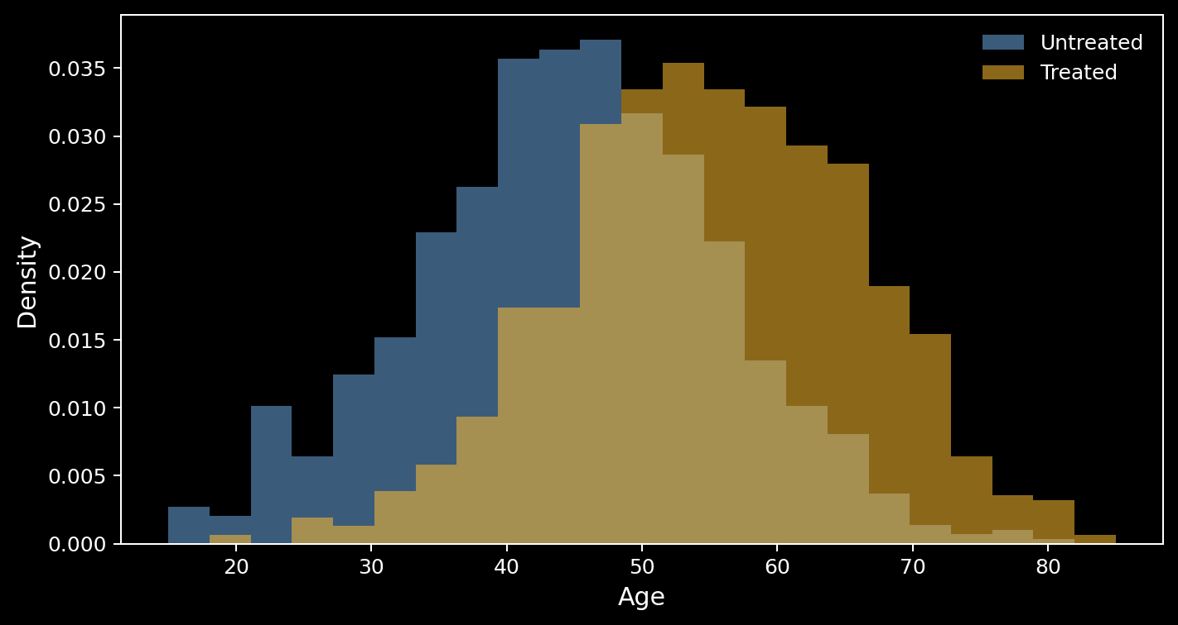
Positivity as Overlap

Slide 48
Positivity Violation
Suppose every patient older than 90 receives the treatment.
P(T=0 | age > 90) = 0
What is the untreated outcome distribution for 95-year-olds?
The observed data do not tell us. Any answer requires extrapolation or a different target population.

Slide 49
Positivity-Unconfoundedness Tradeoff
A richer adjustment set can help one assumption while hurting another.
MORE COVARIATE ADJUSTMENT Can make conditional exchangeability more plausible
BUT... Can reduce overlap and create near-positivity violations
TRADEOFF
Goal: control the confounding that matters without demanding comparisons the data cannot support.

Slide 50

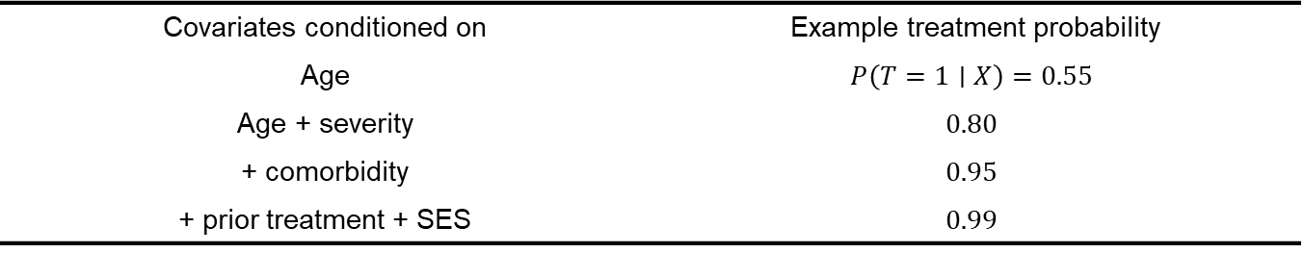
Positivity-Unconfoundedness Tradeoff
Suppose treatment is surgery.
Covariates conditioned on | Example treatment probability
Age | $$P\left(T=1∣X\right)=0.55$$
Age + severity | $$0.80$$
+ comorbidity | $$0.95$$
+ prior treatment + SES | $$0.99$$
Exchangeability: richer $X$ may better account for confounding.
Positivity: richer $X$ may leave almost no treated or untreated comparison subjects within some strata.

Slide 51
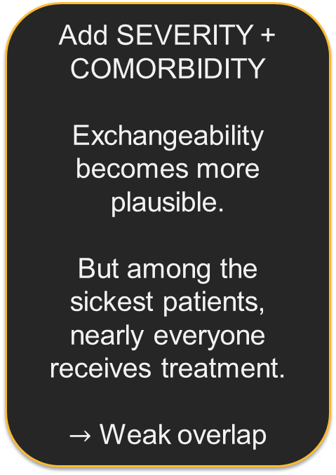
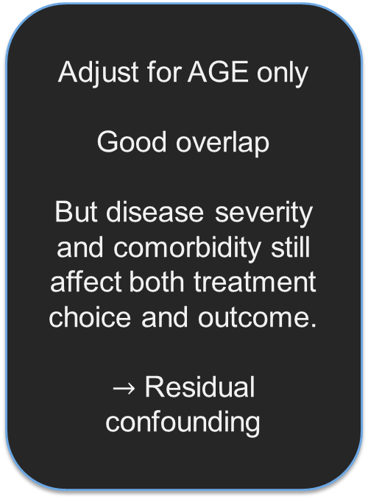
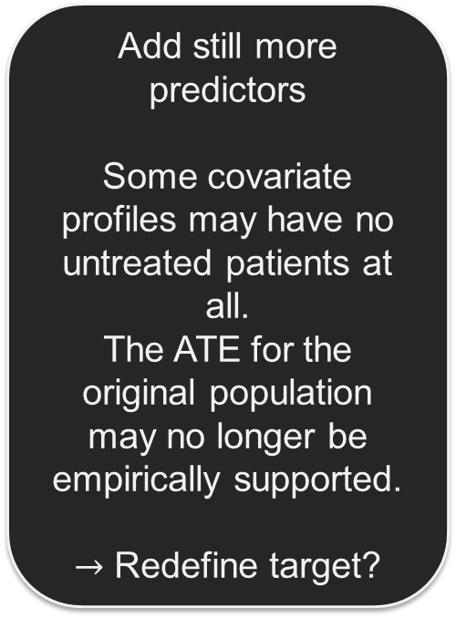
Positivity-Unconfoundedness Tradeoff
Adjust for AGE only Good overlap But disease severity and comorbidity still affect both treatment choice and outcome. $→$ Residual confounding
Add SEVERITY + COMORBIDITY Exchangeability becomes more plausible. But among the sickest patients, nearly everyone receives treatment. $→$ Weak overlap
Add still more predictors Some covariate profiles may have no untreated patients at all. The ATE for the original population may no longer be empirically supported. $→$ Redefine target?

Slide 52
Positivity-Unconfoundedness Tradeoff
1
Choose covariates because of the causal structure
Adjustment is about blocking confounding, not maximizing the number of predictors.
2
Inspect overlap after defining the adjustment set
Look for regions where treatment assignment is nearly deterministic.
3
Avoid unsupported extrapolation
If some patients have no comparable treatment alternative, model-based estimates rely on assumptions outside the data.
4
Sometimes change the estimand or target population
Restrict to common support, trim extreme regions, or target an overlap population when scientifically appropriate.

Slide 53
Assumption Check
A drug is never prescribed during pregnancy.
People who feel healthier are more likely to exercise, but baseline health was not measured.
“Diet = 1” includes keto, vegan, Mediterranean, and intermittent fasting with no further detail.
Students assigned to a tutoring program share the worksheets with untreated classmates.

Slide 54
Assumption Check
A drug is never prescribed during pregnancy.
Positivity.
People who feel healthier are more likely to exercise, but baseline health was not measured.
“Diet = 1” includes keto, vegan, Mediterranean, and intermittent fasting with no further detail.
Students assigned to a tutoring program share the worksheets with untreated classmates.

Slide 55
Assumption Check
A drug is never prescribed during pregnancy.
People who feel healthier are more likely to exercise, but baseline health was not measured.
Conditional Exchangeability.
“Diet = 1” includes keto, vegan, Mediterranean, and intermittent fasting with no further detail.
Students assigned to a tutoring program share the worksheets with untreated classmates.

Slide 56
Assumption Check
A drug is never prescribed during pregnancy.
People who feel healthier are more likely to exercise, but baseline health was not measured.
“Diet = 1” includes keto, vegan, Mediterranean, and intermittent fasting with no further detail.
Consistency.
Students assigned to a tutoring program share the worksheets with untreated classmates.

Slide 57
Assumption Check
A drug is never prescribed during pregnancy.
People who feel healthier are more likely to exercise, but baseline health was not measured.
“Diet = 1” includes keto, vegan, Mediterranean, and intermittent fasting with no further detail.
Students assigned to a tutoring program share the worksheets with untreated classmates.
No Interference / SUTVA.

Slide 58

Assumption to Identifiability
ATE = $E\left[Y\left(1\right)− Y\left(0\right)\right]$
= $E\left[Y\left(1\right)\right] − E\left[Y\left(0\right)\right]$
We want to rewrite this causal quantity using things observable in the data.

Slide 59

Adjustment formula: Condition on X
Law of iterated expectation gives:
$$E[Y(1)] = Eₓ\{E[Y(1) | X]\}$$
$$E[Y(0)] = Eₓ\{E[Y(0) | X]\}$$
ATE = $Eₓ\left\{E\left[Y\left(1\right) | X\right]− E\left[Y\left(0\right) | X\right]\right\}$

Slide 60
Adjustment formula: Use exchangeability
$$(Y(1),Y(0)) ⫫ T | X$$
$$E\left[Y\left(1\right) | X\right] = E\left[Y\left(1\right) | T=1,X\right]$$
$$E\left[Y\left(0\right) | X\right] = E\left[Y\left(0\right) | T=0,X\right]$$
Within X, treated and untreated units represent the same potential-outcome distribution.

Slide 61

Adjustment formula: Use Positivity
To write $E\left[Y\left(1\right)|T=1, X\right]$, we need:
$$P(T=1|X=x).$$
Similarly, we also need $P(T=0|X=x)>0$.
Otherwise, for some $x$, $E\left[Y\left(1\right) | T=1, X=x\right]$ has no data behind it.
Exchangeability tells us whom we may compare; positivity ensures both groups actually exist to make that comparison.

Slide 62

Adjustment formula: Use Consistency
If $T=t$, then $Y = Y(t)$
$$E\left[Y\left(1\right) | T=1,X\right] = E\left[Y | T=1,X\right]$$
$$E\left[Y\left(0\right) | T=0,X\right] = E\left[Y | T=0,X\right]$$
$$ATE = Eₓ\left[ E\left(Y | T=1,X\right)− E\left(Y | T=0,X\right)\right]$$

Slide 63

From counterfactuals to observed data
$E\left[Y\left(1\right)– Y\left(0\right)\right]−$Causal Estimand
Exchangeability, Positivity, Consistency, SUTVA
$$E_{X}\left[E\left(Y \right|T=1, X)\right] −E\left[Y| T=0, X\right]$$
This is identification: the causal estimand is now written using quantities available in the observed data.
This is standardization / the g-formula in its simplest form.

Slide 64
From counterfactuals to observed data
Identification
Can we express the causal estimand as a function of the observed-data distribution?
Estimation
How do we estimate that function from a finite sample?
The assumptions justify the observed-data target. Regression, matching, IPW, and machine learning are ways to estimate that target. They do not create causality.

Slide 65
Causal Flowchart
Question
Estimand
Assumptions
Identification
Estimator
Estimate
The order matters: define the question and estimand, justify identification, then choose an estimator.

Slide 66
Simulation Study
Outcome: systolic blood pressure
Treatment truly lowers BP by 5 mmHg for everyone
Older patients are more likely to receive treatment
Age also raises blood pressure
Therefore, treatment assignment is confounded by age.
In a simulation we can store both Y(0) and Y(1) — something impossible in real data.

Slide 67
Simulation Study
set.seed(123)
n <- 2000
age <- rnorm(n, 50, 12)
# Older patients are more likely to be treated
p_treat <- plogis(-4 + 0.08 * age)
T <- rbinom(n, 1, p_treat)
# Potential outcomes: treatment lowers BP by 5
Y0 <- 120 + 0.6 * age + rnorm(n, 0, 8)
Y1 <- Y0 - 5
# Only one potential outcome becomes observed
Y <- ifelse(T == 1, Y1, Y0)
dat <- data.frame(age, T, Y, Y0, Y1)

Slide 68
Simulation Study
True effect: −5
# True causal effect -- available only because this is simulation
mean(dat$Y1 - dat$Y0)
# [1] -5
# What an observational analyst sees
with(dat, mean(Y[T == 1]) - mean(Y[T == 0]))
# about +1.34 mmHg
Naive difference: +1.34
The sign is wrong.

Slide 69
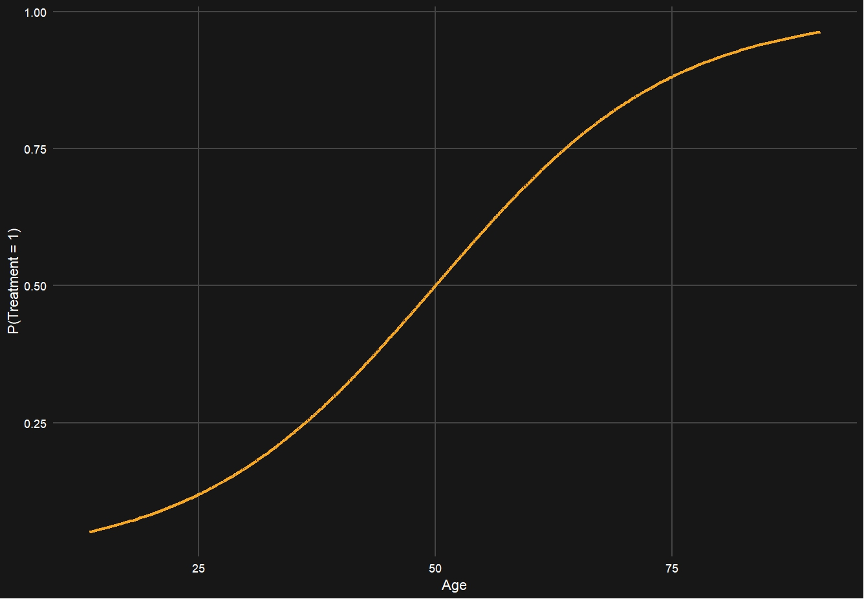
Why naïve comparison wrong

Slide 70
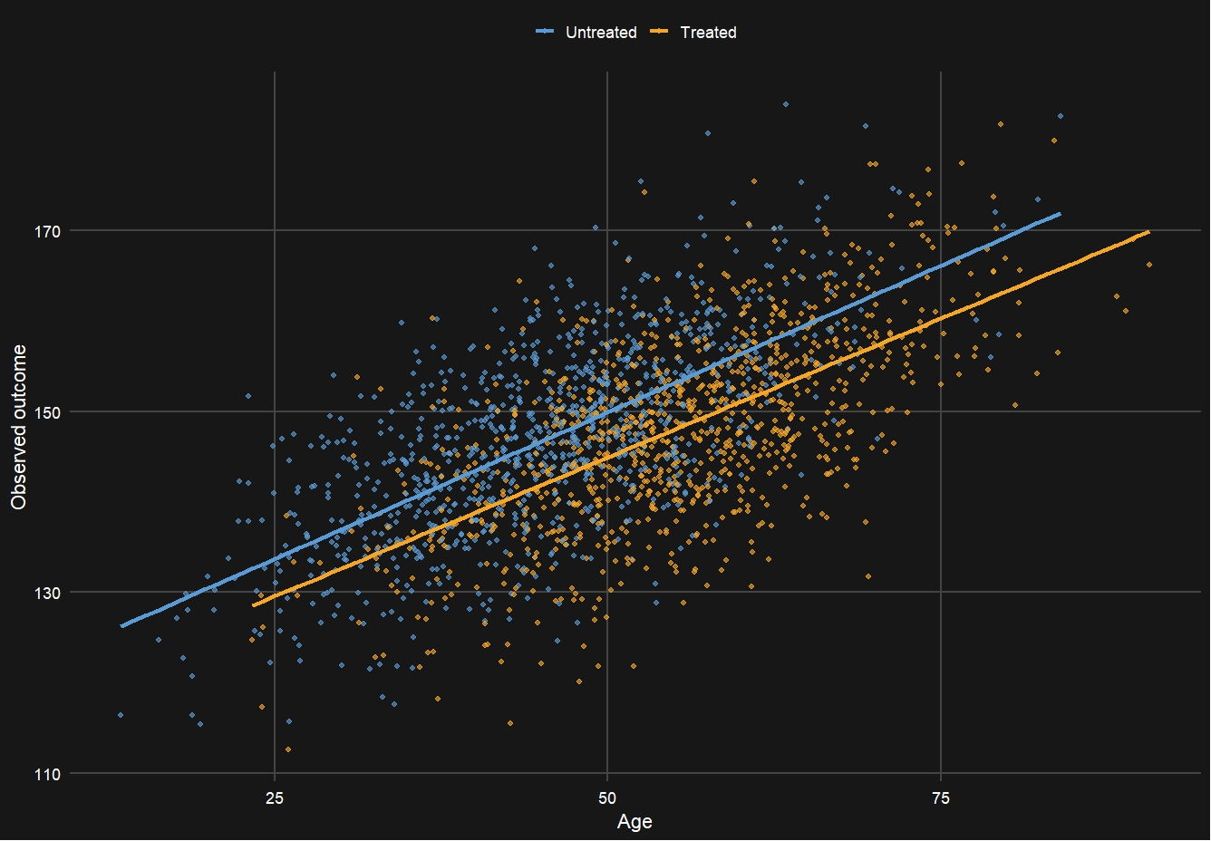
Treated and Untreated groups have different population
Older patients have higher BP and are more likely to receive treatment; the causal −5 mmHg effect is masked.

Slide 71
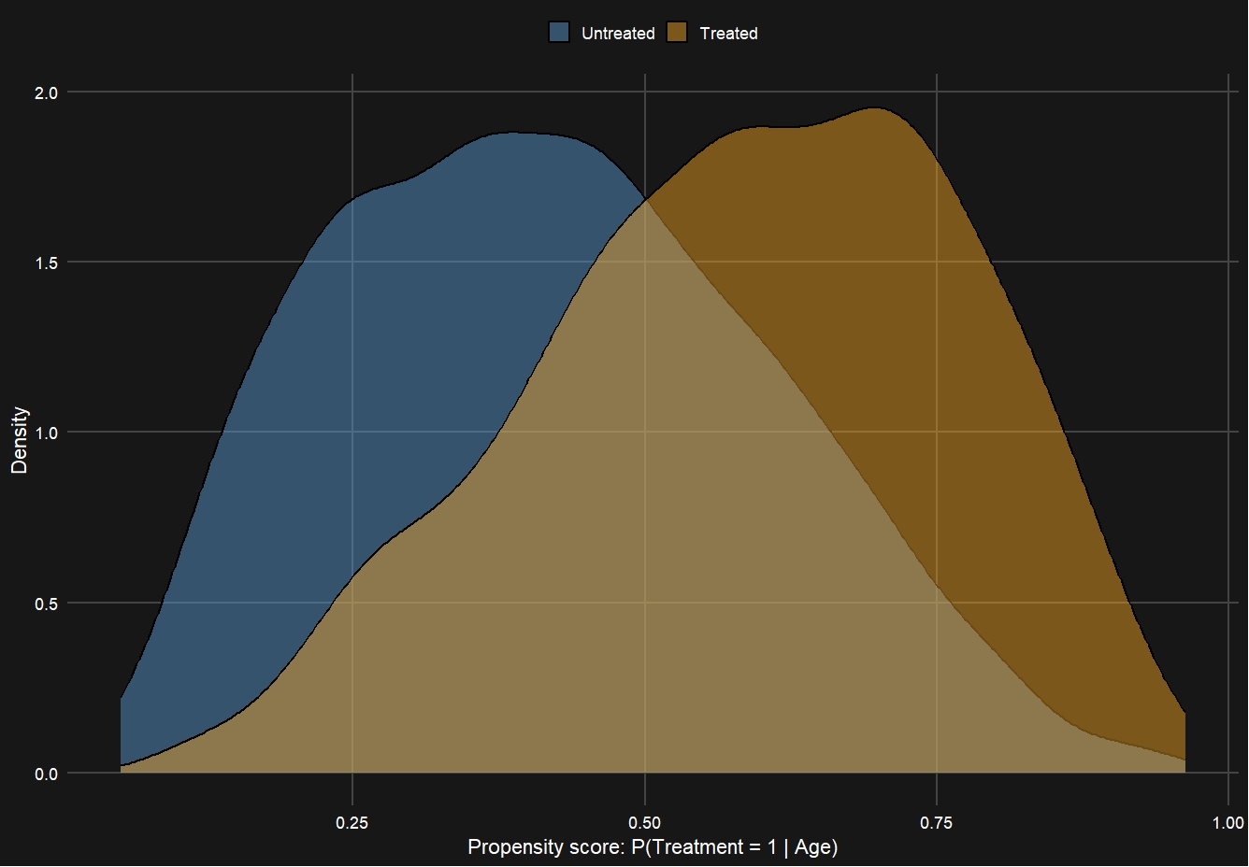
Overlap Check

Slide 72
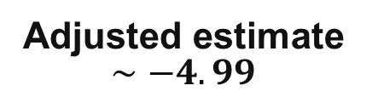
Simulation Study
True effect: −5
fit <- lm(Y ~ T + age, data = dat)
summary(fit)
# Coefficient of T is approximately
# - 4.998725
Adjusted estimate $∼−4.99$
Adjustment recovers the causal effect because the model and assumptions match the simulation.

Slide 73
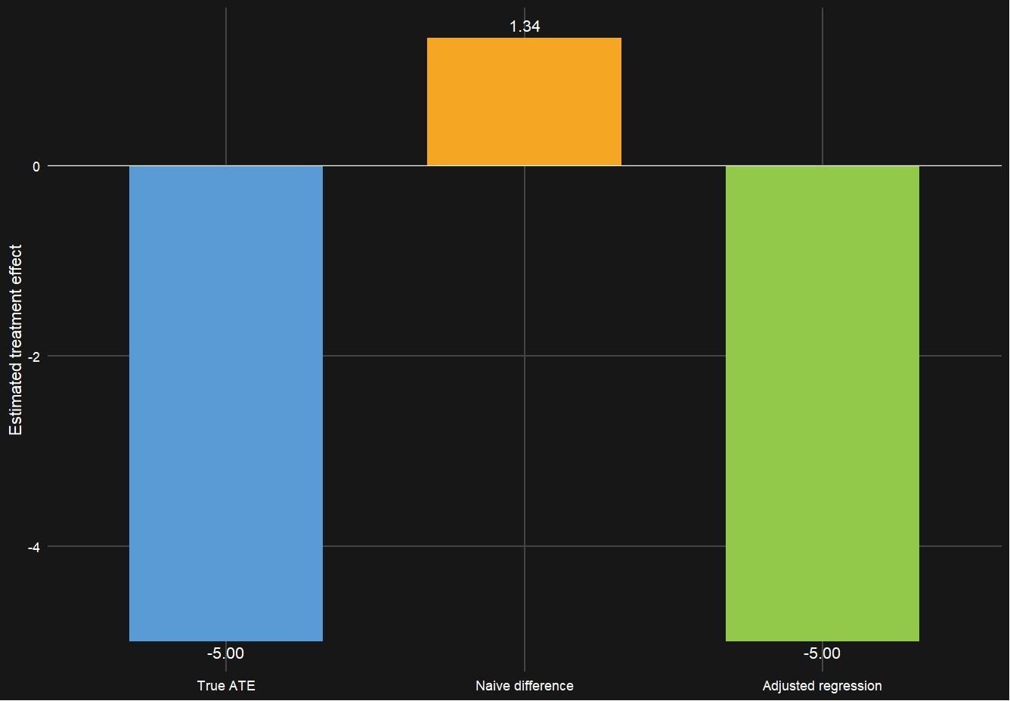
Why naïve comparison wrong

Slide 74
Regression Coefficient is not automatically causal
$lm(Y \sim T + X)$does not create exchangeability.
Did we adjust for the right pre-treatment confounders?
Did we accidentally adjust for a mediator or collider?
Is there adequate overlap?
Is the functional form adequate?
Is the target estimand the regression coefficient we are interpreting?
Mediator: A variable on the causal pathway from treatment to outcome.
Collider: A variable caused by both treatment and another factor.

Slide 75
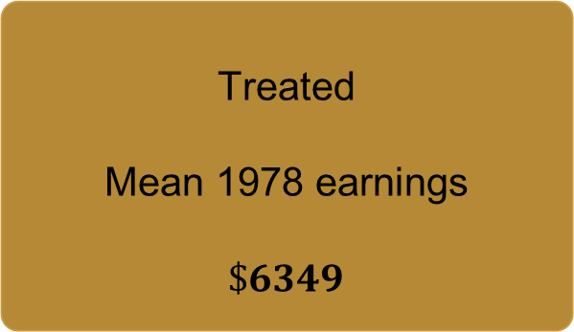
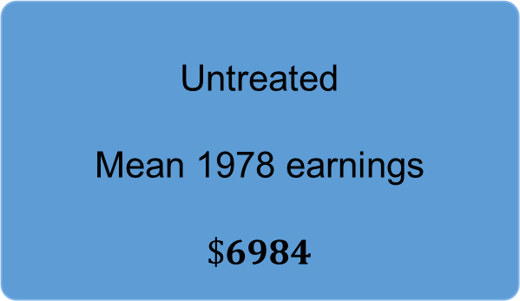

Real Data Analysis: LaLonde / NSW Job training
Untreated
Mean 1978 earnings
$$\$6984$$
Treated
Mean 1978 earnings
$$\$6349$$
Question: Did job training increase later earnings?
Naïve Difference: $−\$635$

Slide 76
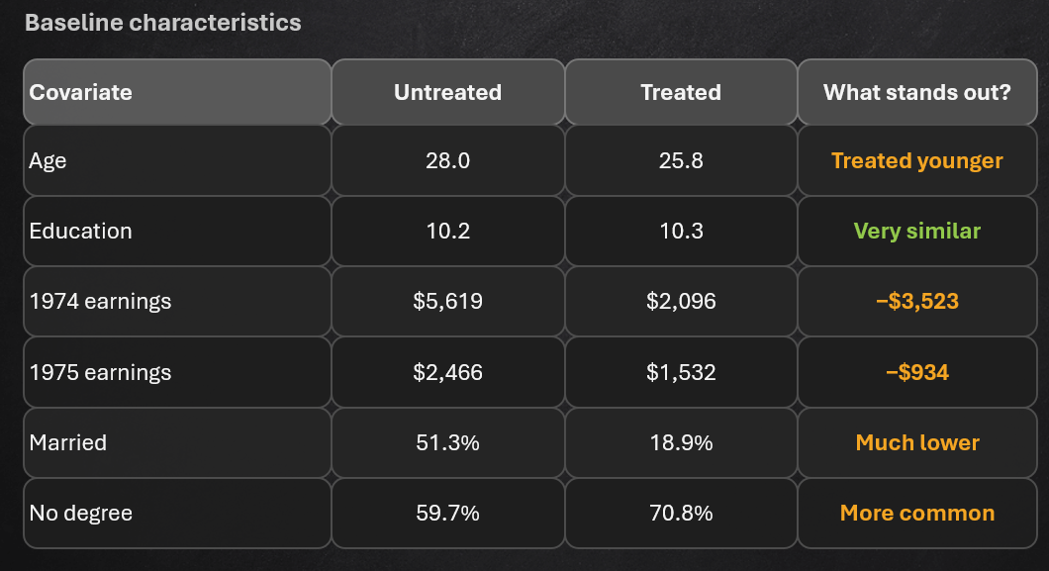
Real Data Analysis: LaLonde / NSW Job training
Treatment participation was associated with characteristics that also predict later earnings.
So, the raw $6,349 vs $6,984 comparison mixes treatment effect with baseline differences.

Slide 77
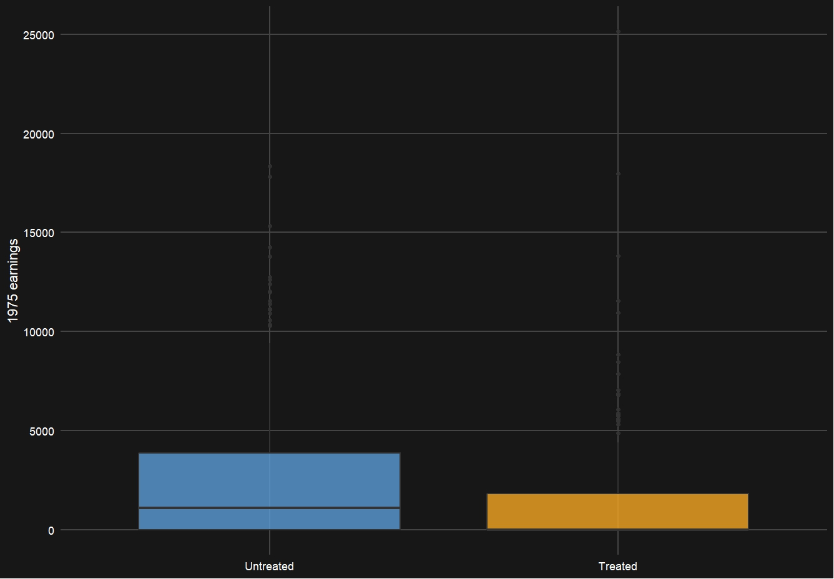
Real Data Analysis: LaLonde / NSW Job training

Slide 78
Real Data Analysis: LaLonde / NSW Job training
Naive comparison
Adjust for age, education, race,
marriage, degree status, re74, re75
Adjusted estimate
−$635
+$1,548
treated minus untreated
regression / g-computation
The sign changed from negative to positive after accounting for baseline differences.
That is exactly why “association” and “causal effect” are different questions.

Slide 79
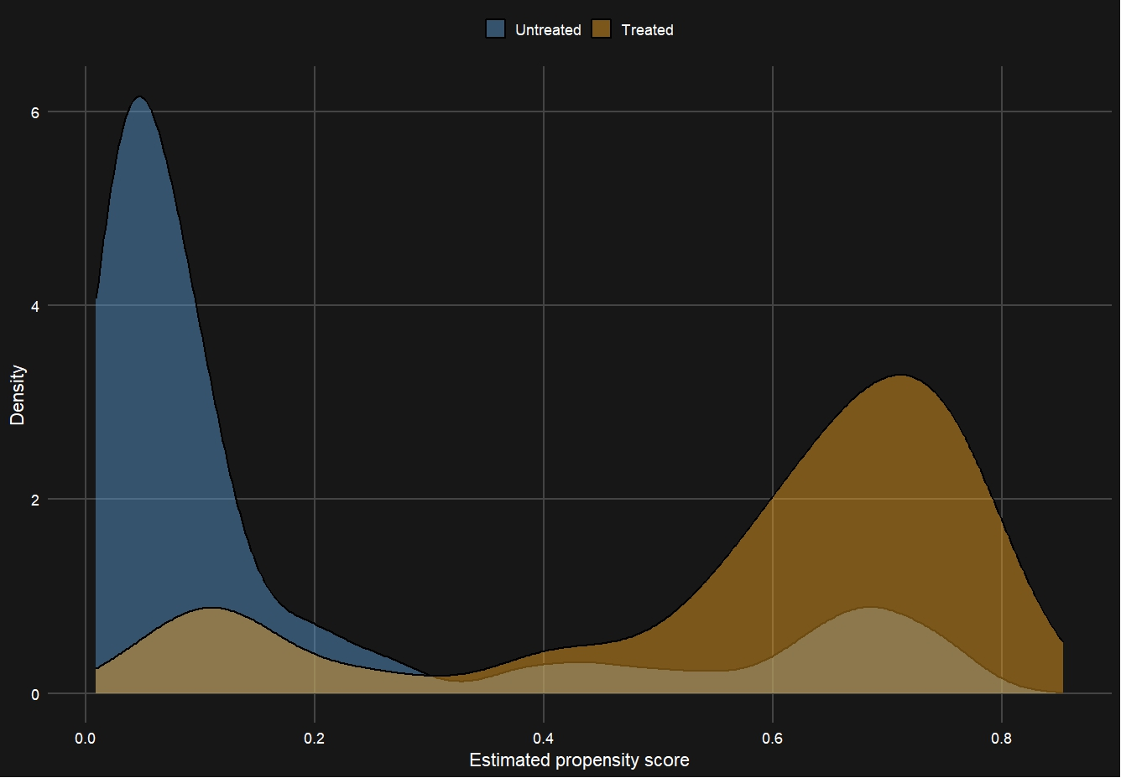
Real Data Analysis: Overlap Plot
Propensity Score Distribution
What do we see?
Untreated participants are concentrated at low propensity scores.
Treated participants are concentrated at much higher scores.
There is some common support, but the overlap is limited.
Practical positivity concern

Slide 80
Real Data Analysis: LaLonde
What did we learn from the data analysis?
The naive comparison suggested training decreased earnings by about $635.
Baseline characteristics showed strong differences between treated and untreated people.
Regression adjustment changed the estimate to approximately $1,548.
But the propensity score plot revealed poor overlap.

Slide 81

Real Data Analysis: LaLonde
Therefore: $\$635$ is clearly a crude association.
$\$1548$ is an adjusted causal estimate under assumptions, but its credibility is limited by poor overlap.
Possible Solutions:
Restrict to common support (Change the target population)
Propensity-Score Matching
IPW (Can be problematic with poor overlap)
If there is zero overlap, then no statistical adjustment method can recover the missing counterfactual from these data without additional assumptions.

Slide 82

Conclusion
Potential outcomes give us the language of causality.
$$Y\left(1\right), Y\left(0\right), ATE=Y\left(1\right)−Y\left(0\right)$$
But for each person, we only observe one potential outcome.
Moving from association to causation requires assumptions:
Exchangeability: treated and untreated are comparable after conditioning on $X.$
Consistency: observed treatment corresponds to the intervention we defined.
SUTVA / no interference: one person’s treatment does not alter another’s outcome.
Positivity: both treatment options are represented within relevant covariate profiles.
Identification comes before estimation. $E\left[Y\left(a\right)\right]=E_{X}\left\{E\left(Y|A=a, X\right)\right\}.$
A statistical model can always produce an estimate.
Causal inference asks whether the data and assumptions support interpreting the estimate causally.
Note: You cannot fully verify all causal assumptions from the observed data.

